Slide 1
StudyBuddy
A Modern Learning Management System for Education

Slide 2

Our Team :
Ait Aadi Youssef
Ait Lahcen Mohamed
mohamed.aitlahcen@um6p.ma
+212 774-701718
youssef.aitaadi@um6p.ma
+212631622661
Supervisors :
Prof Yahya Benkaouz
Prof Imane Fouad
yahya.benkaouz@um6p.ma
imane.fouad@um6p.ma

Slide 3
Table of contents
01
Problem and solution
02
Actors
03
System Requirements
04
Core Features Overview
05
Core Workflows
06
System Architecture
07
Feasibility Analysis

Slide 4

01
Problem and solution

Slide 5
The problem
Universities and schools face difficulties managing communication, assignments, grading, and class-based access using outdated or fragmented tools.
Existing LMS solutions are often expensive, complex, or not adapted to local academic

Slide 6





Solution:
StudyBuddy is a modern Learning Management System designed to centralize teaching and learning activities within a university or a school. It provides a unified environment for managing courses, assignments, content distribution, grading, communication, and academic organization across all roles. The platform improves efficiency, enhances collaboration, and streamlines academic workflows through a clean and scalable architecture.

Slide 7

02
Actors

Slide 8

Students:
-Access courses, modules, assignments, grades
-Participate in real-time discussions
-Manage personal to-do list

Slide 9

Teachers:
-Create modules and assignments
-Grade submissions and provide feedback
-Communicate with students

Slide 10

Administrators:
-Create courses
-Assign teachers and classes
-Oversee academic structure

Slide 11
03
System Requirements

Slide 12
Functional Requirements
Req 1
Req 2
Req 3
Req 4
Req 5
Course, module, assignment, submission, and grading management
Real-time discussion per course
Dashboard event notifications
Student task management
Authentication & role-based access control

Slide 13
Non-Functional Requirements
Req 1
Req 2
Req 3
Req 4
Req 4
maintainability
Performance
usability
scalability
security

Slide 14
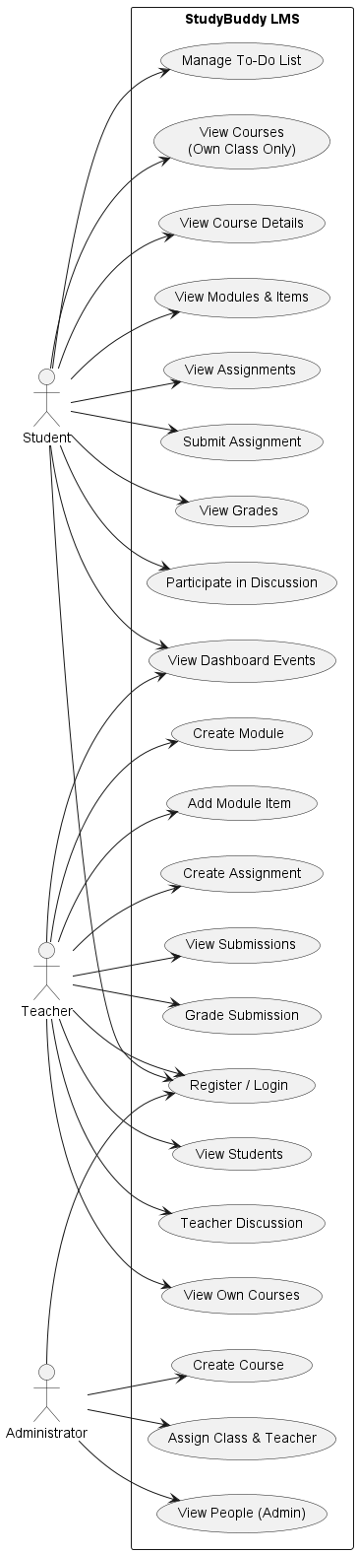
Use Case diagram

Slide 15

04
Core Features Overview

Slide 16
StudyBuddy includes:
01
Role-based JWT authentication
05
Grading tools for teachers
02
06
Real-time STOMP WebSocket chat
Course creation & class assignment
03
07
Dashboard notifications
Structured learning modules
04
08
Assignments & submission workflows
Personal to-do list for students

Slide 17
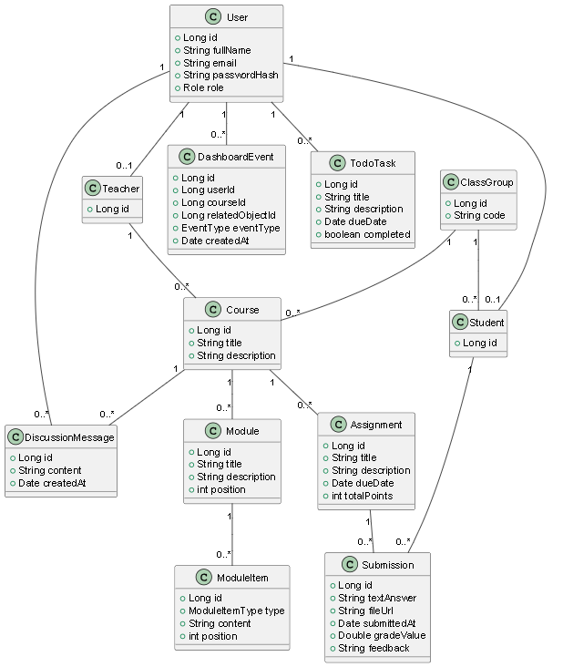
Class Diagram

Slide 18
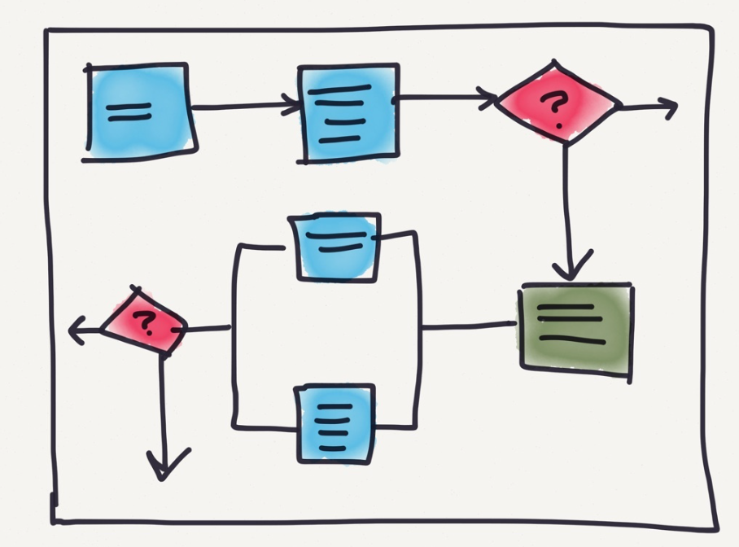
05
Core Workflows

Slide 19
-Course Workflow : Admin creates → Assigns teacher & class → Students access automatically -Assignment Workflow Teacher publishes → Students submit → Teacher grades → Dashboard updates -Module Workflow Teacher uploads content → Students view immediately -Discussion Workflow Real-time synchronized chat across all user clients

Slide 20
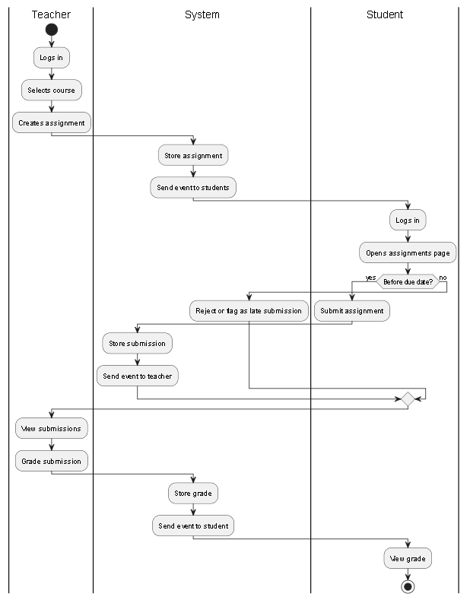
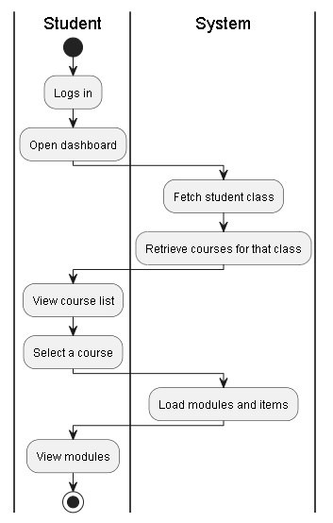
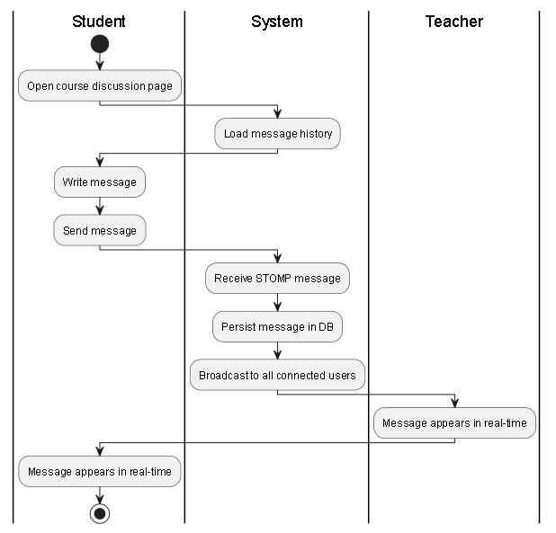
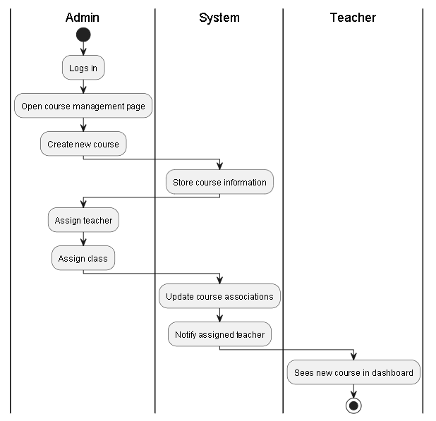
Activity diagrams
Course
Discussion
Assignment
Module

Slide 21

System Architecture
06

Slide 22








Tools :
Frontend
Backend
Database
Communication
Security

Slide 23
07
Feasibility Analysis

Slide 24
Technical Feasibility
Economic Feasibility
Operational Feasibility
Schedule Feasibility
The system is technically feasible, even though we used new technologies (Spring Boot, React, WebSockets) and faced a framework change that increased the learning curve.
Fully feasible economically since all tools and technologies used are free and open source.
Operationally feasible thanks to clear user roles and workflows, despite our limited initial experience with LMS platforms.
Time was the biggest constraint, as we had to learn the technologies while developing the system, which reduced testing and refinement time.

Slide 25
demo

Slide 26
Thanks!
Do you have any questions?

